Slide 1
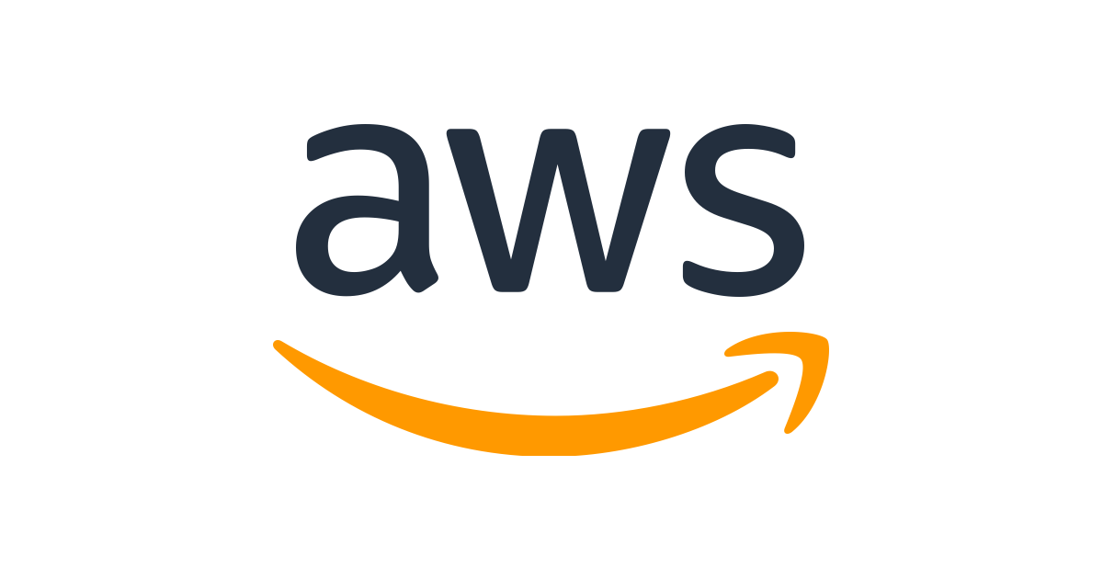
AWS Integrations Learning Paths | Self-Paced
This self-paced program will help the practioner to learn AWS Integration with different iPaaS tools.
7
AWS CICD
1 hr. 30 min
10
Kinesis Overview and Hands-on
60 min
Audit and Logging
SNS Messaging Service
20 min
6
2h
1h
End
SQS Messaging Service
40 min
5
CICD in AWS
AWS Monitoring Overview
5 min
11
Introduction to AWS Cloud (Getting Started)
12 min
2
1.5h
1h
Integration Patterns - Asynchronous
Other Integration Patterns
CloudWatch Introduction and Hands-on
25 min
Section-wise course links for each Module for detailed, conceptual understanding is attached
12
Introduction to AWS
7 min
1
Step Functions Overview and Hands-on
20 min
8
Integration Patterns - Synchronous
13
1h
1.5h
9
Introduction to AWS event-Bridge and Hands-on
30 min
AppSync Overview and Hands-on
20 min
Introduction to AWS and AWS Cloud
Amazon Serverless Lambda
21 min
3
API Gateway
1.5 hrs.
4
Week 1
Week 2
Required Study – 8 hours ( 2 weeks )
Udemy
(Recommended)

